Slide 1
EECS 490 – Lecture 8 Functional Programming Examples

Slide 2
Announcements
Homework 2 due on Friday
Project 2 due Fri 10/6

Slide 3
Review: Environment of Use
A function passed as a parameter has three environments that can be associated with it
The environment where it was defined
The environment where it was referenced
The environment where it was called
Scope policy determines which names are visible in the function
Static/lexical scope: names visible at the definition point
Dynamic scope: names visible at the point of use
In dynamic scope, point of use can be where a function is referenced or where it is called

Slide 4
Review: Binding Policy
Shallow binding: non-local environment is environment from where a function is called
Deep binding: non-local environment is environment from where a function is referenced int foo(int (*bar)()) { int x = 3; return bar(); } int baz() { return x; } int main() { int x = 4; print(foo(baz)); }
Non-local environment in shallow binding
Non-local environment in deep binding

Slide 5
Agenda
Nested Functions
Example: Iterative Improvement

Slide 6
Nested Functions and Closures
The ability to create a function from within another function is a key feature of functional programming
Static scope requires that the newly created function have access to its definition environment
A closure is the combination of a function and its enclosing environment
Variables from the enclosing environment that are used in the function are captured by the closure

Slide 7
Nested Functions and State
A closure encompasses state that can be accessed by the newly created function def make_greater_than(threshold): def greater_than(x): return x > threshold return greater_than
threshold captured from non-local environment
>>> gt3 = make_greater_than(3)
>>> gt30 = make_greater_than(30)
>>> gt3(2)
False
>>> gt3(20)
True
>>> gt30(20), gt30(200)
(False, True)

Slide 8
Modifying Non-Local State
Languages may allow non-local variables to be modified
def make_account(balance): def deposit(amount): nonlocal balance balance += amount return balance def withdraw(amount): nonlocal balance if 0 <= amount <= balance: balance -= amount return amount else: return 0 return deposit, withdraw
>>> deposit, withdraw = \
make_account(100)
>>> withdraw(10)
10
>>> deposit(0)
90
>>> withdraw(20)
20
>>> deposit(0)
70
>>> deposit(10)
80
>>> withdraw(100)
0
>>> deposit(0)
80

Slide 9
Decorators
A common pattern in Python is to transform a function or class by applying a higher-order function to it, called a decorator
Standard syntax for decorating functions: @<decorator> def <name>(<parameters>): <body>
Mostly equivalent to: def <name>(<parameters>): <body> <name> = <decorator>(<name>)

Slide 10
Trace Example
Example: decorator that traces function calls def trace(fn): def tracer(*args): strs = (str(arg) for arg in args) print('{}({})'.format(fn.__name__, ', '.join(strs))) return fn(*args) return tracer @trace def factorial(n): if n == 0: return 1 return n * factorial(n - 1)
>>> factorial(5)
factorial(5)
factorial(4)
factorial(3)
factorial(2)
factorial(1)
factorial(0)
120

Slide 11
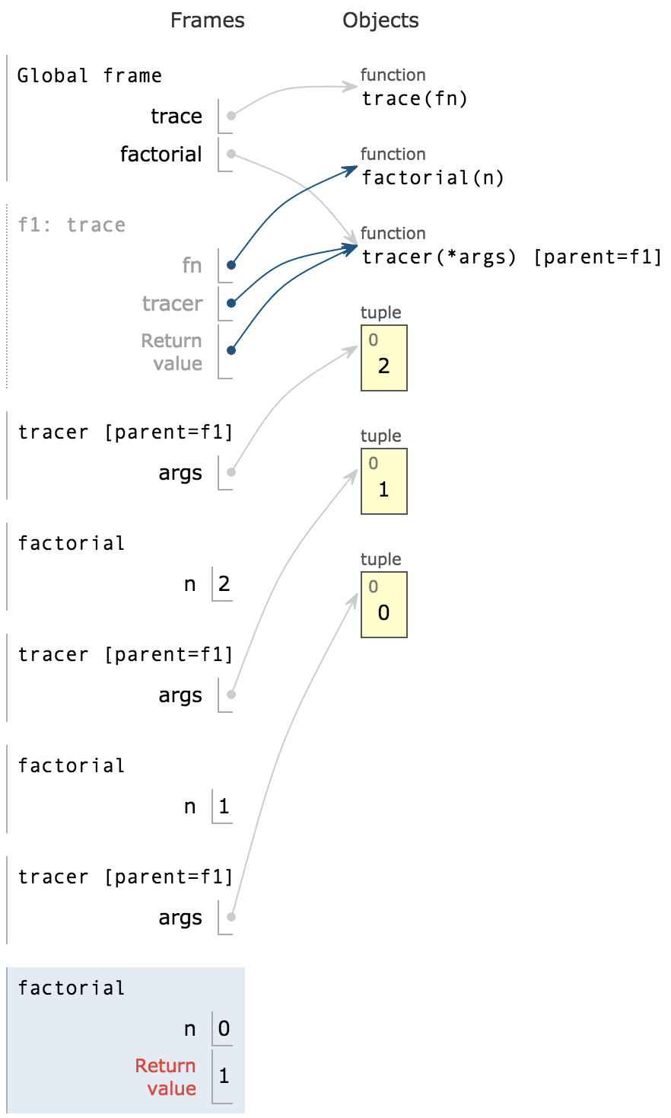
Mutual Recursion
A decorated recursive function results in mutual recursion where multiple functions make recursive calls indirectly through each other
>>> factorial(2)
factorial(2)
factorial(1)
factorial(0)
2

Slide 12
Partial Application
Specify some arguments to a function, then specify remaining arguments later
If function takes n arguments and k are supplied, results in function that takes n-k arguments def partial(func, *args): def newfunc(*nargs): return func(*args, *nargs) return newfunc >>> power_of_two = partial(pow, 2) >>> power_of_two(3) 8 >>> power_of_two(7) 128

Slide 13
Currying
Transforms a function that takes n arguments into a series of n functions that each in one argument
In some languages, all functions are curried def curry2(func): def curriedA(a): def curriedB(b): return func(a, b) return curriedB return curriedA >>> curried_pow = curry2(pow) >>> curried_pow(2)(3) 8

Slide 14
Uncurrying
We can also do the reverse transformation def uncurry2(func): def uncurried(a, b): return func(a)(b) return uncurried >>> uncurried_pow = uncurry2(curried_pow) >>> uncurried_pow(2, 3) 8

Slide 15
Break Time!
We’ll start again in five minutes.

Slide 16
Iterative Improvemnt
A pattern of computation that begins with an initial guess and repeatedly updates the guess until it is close enough to the intended value
We can implement this using higher-order functions: def improve(update, is_close, guess): while not is_close(guess): guess = update(guess) return guess

Slide 17
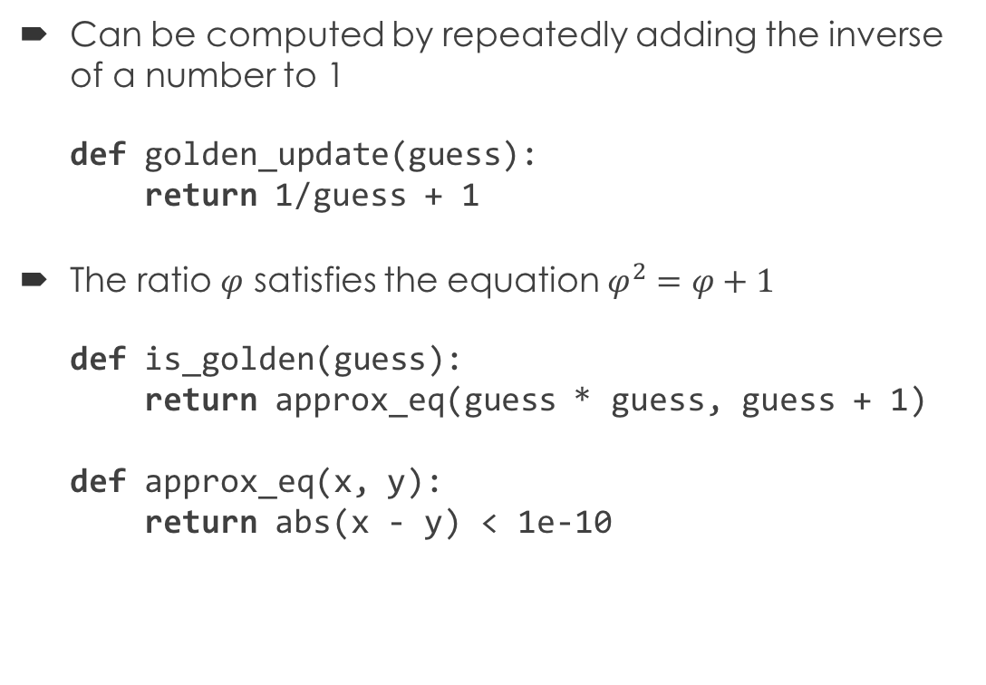
Golden Ratio
Can be computed by repeatedly adding the inverse of a number to 1 def golden_update(guess): return 1/guess + 1
The ratio $φ$ satisfies the equation $φ^{2}=φ+1$ def is_golden(guess): return approx_eq(guess * guess, guess + 1) def approx_eq(x, y): return abs(x - y) < 1e-10
>>> improve(golden_update, is_golden, 1)
1.6180339887802426

Slide 18
Scheme Implementation
Improvement function uses tail recursion (define (improve update close? guess) (if (close? guess) guess (improve update close? (update guess)))) (define (golden-update guess) (+ (/ 1 guess) 1)) (define (golden? guess) (approx-eq? (* guess guess) (+ guess 1))) (define (approx-eq? x y) (< (abs (- x y)) 1e-10))

Slide 19
Square Root
We can use iterative improvement, but we don't want to write separate update and is_close functions for each input
Instead, we define these functions dynamically as local functions: (define (isqrt a) (define (update x) (average x (/ a x))) (define (close? x) (approx-eq? (* x x) a)) (improve update close? 1.0)) (define (average x y) (/ (+ x y) 2))

Slide 20
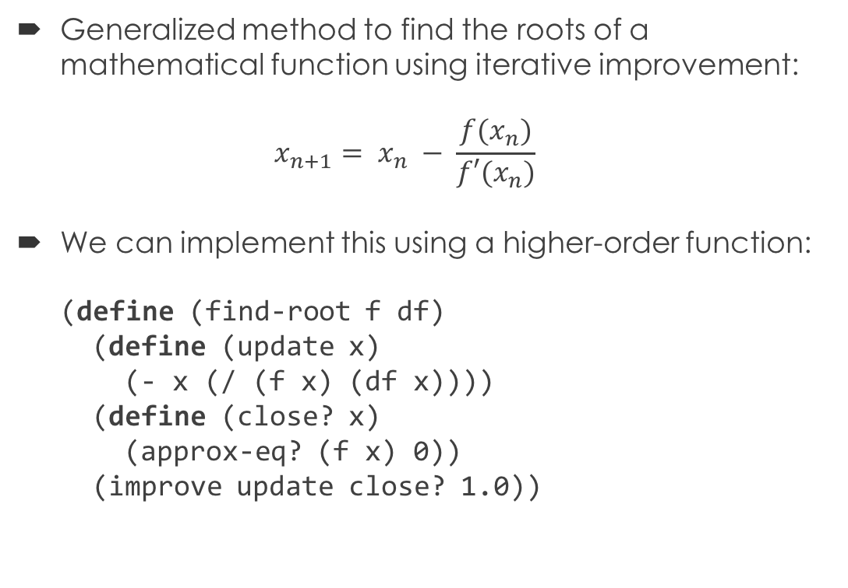
Newton's Method
Generalized method to find the roots of a mathematical function using iterative improvement: $x_{n+1}= x_{n} − \frac{f(x_{n})}{f′(x_{n})}$
We can implement this using a higher-order function: (define (find-root f df) (define (update x) (- x (/ (f x) (df x)))) (define (close? x) (approx-eq? (f x) 0)) (improve update close? 1.0))

Slide 21
Nth Roots
We can now use Newton's method to compute the nth root of a number: (define (nth-root n a) (define (f x) (- (expt x n) a)) (define (df x) (* n (expt x (- n 1)))) (find-root f df))
> (nth-root 2 4) 2.000000000000002 > (nth-root 4 4)
1.4142135623730951 > (nth-root 8 16)
1.414213562373095

